Slide 1
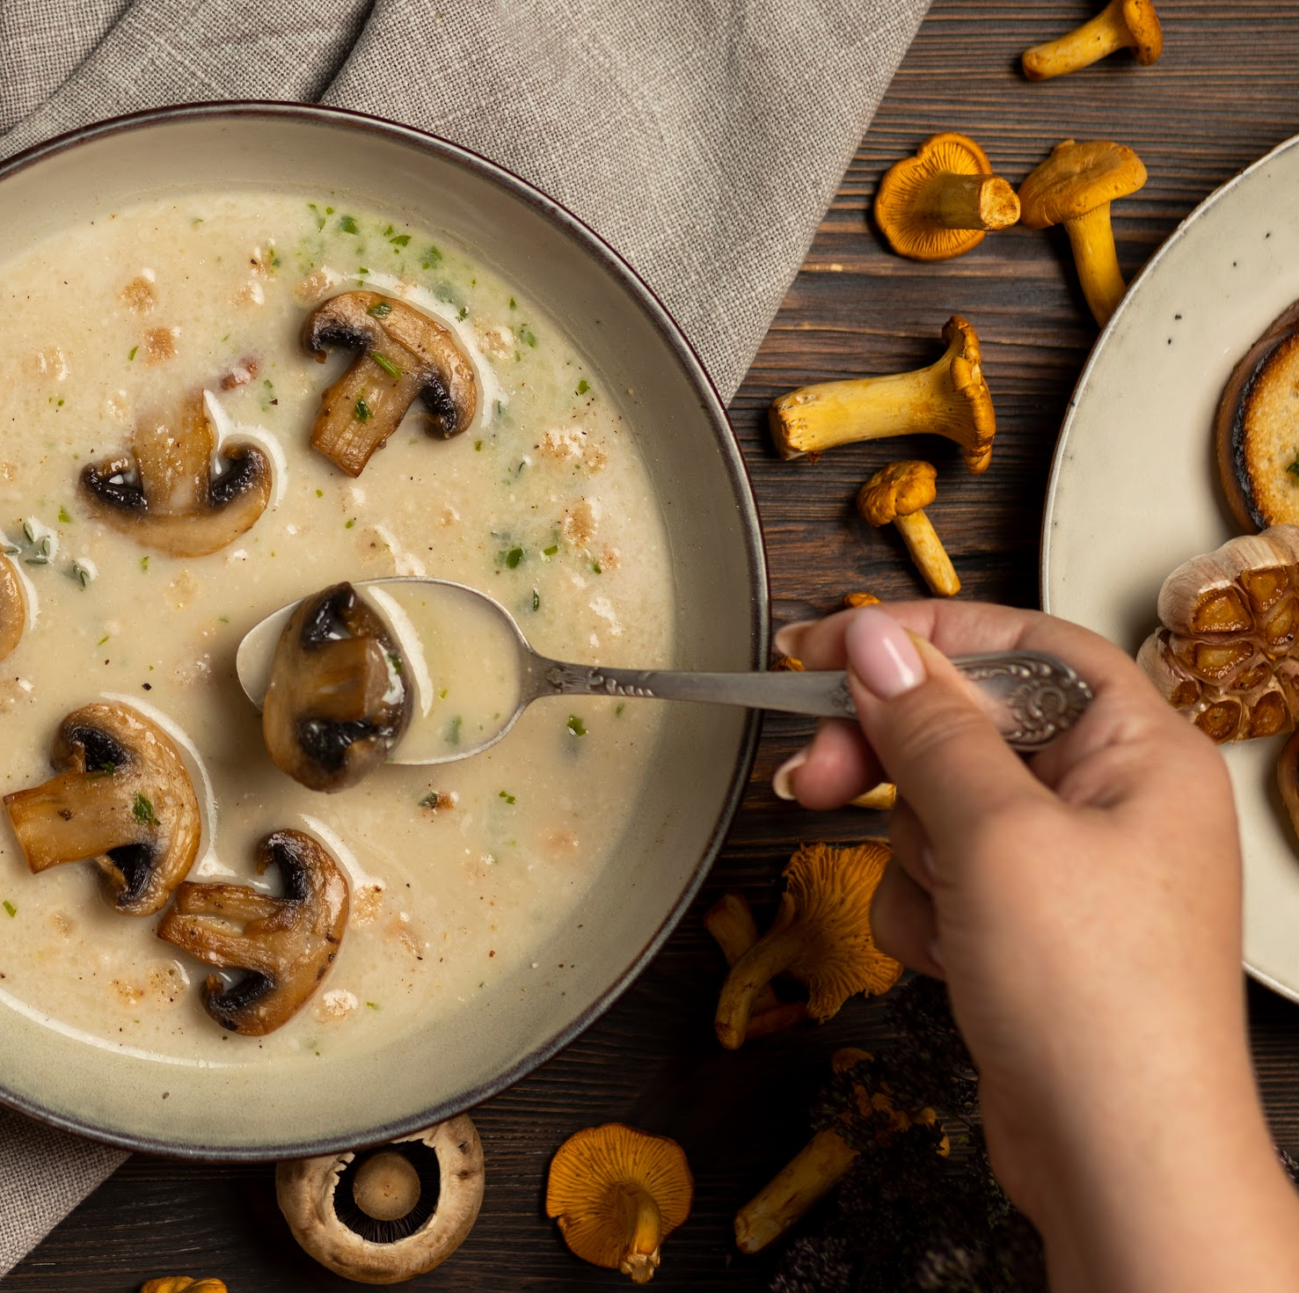
Mushrooms out of Waste
Team 12 NICE Summer School 2023
Anushka Jain (UCD)
Maria Olivia Widjaya (UniPd)
Bernadette Fitzerald (Edinburgh)
Olha Panchenko (Kyiv)
Julien Haumont (Amsterdam)

Slide 2
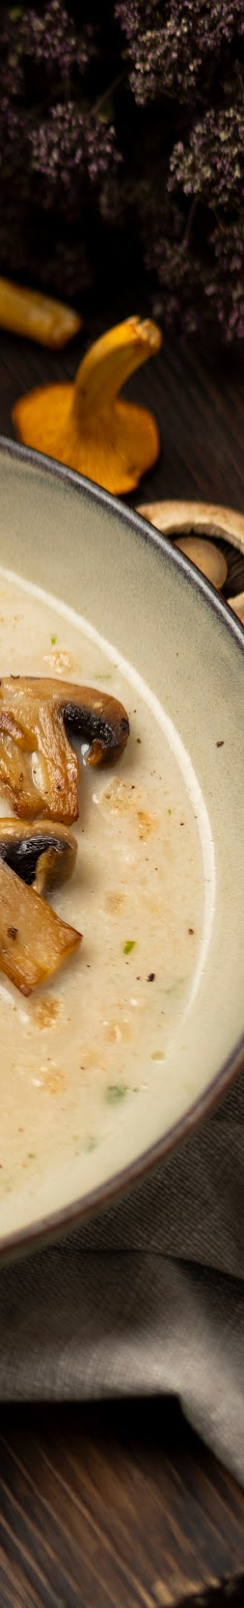
TABLE OF CONTENTS
01
02
Problem Description
Program Implementation

Slide 3
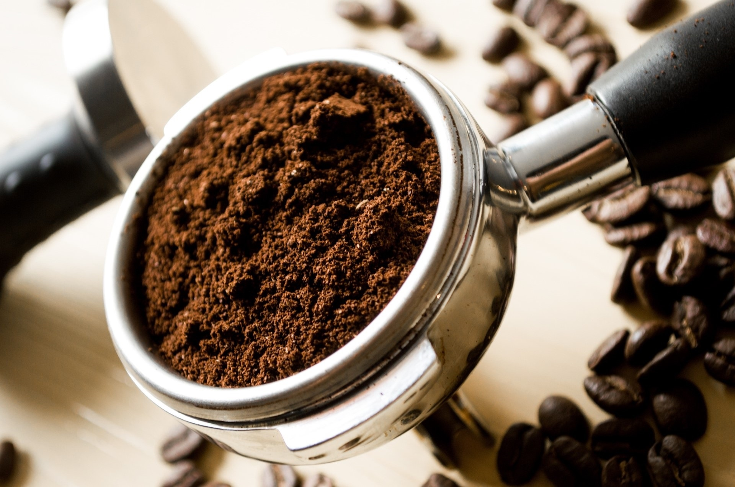
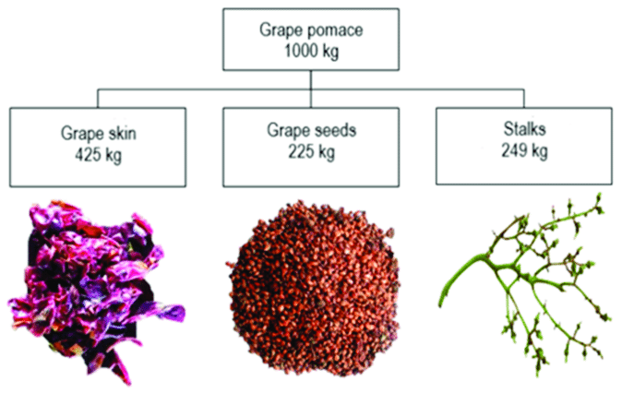
01
Problem Description
Inefficient waste management and disposal practices contribute to environmental degradation and resource depletion.
Waste materials such as paper, coffee grounds, and grape pomace pose significant challenges in terms of disposal and sustainability.

Slide 4
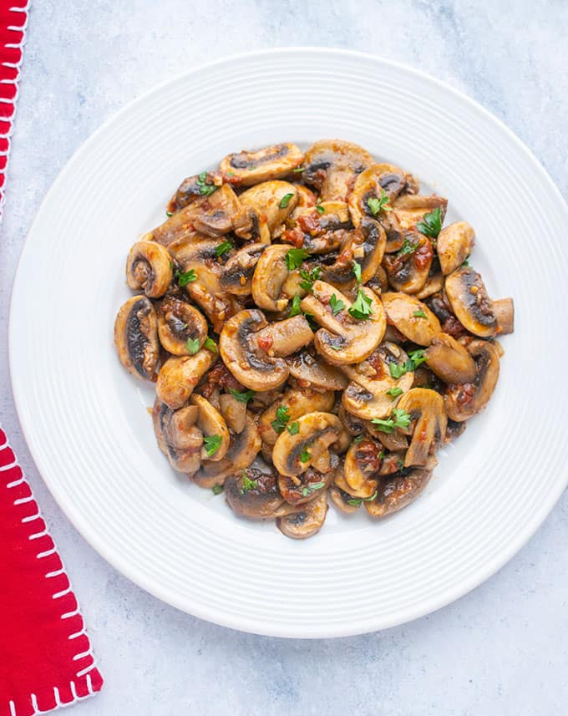
Solution
Italians buy and consume mushrooms in all forms: raw, washed, sliced, in soup, cooked or frozen. 70% of mushrooms sold are fresh, the remaining 30% are processed.
Notes:
https://www.businesscoot.com/en/study/the-mushroom-market-italy

Slide 5
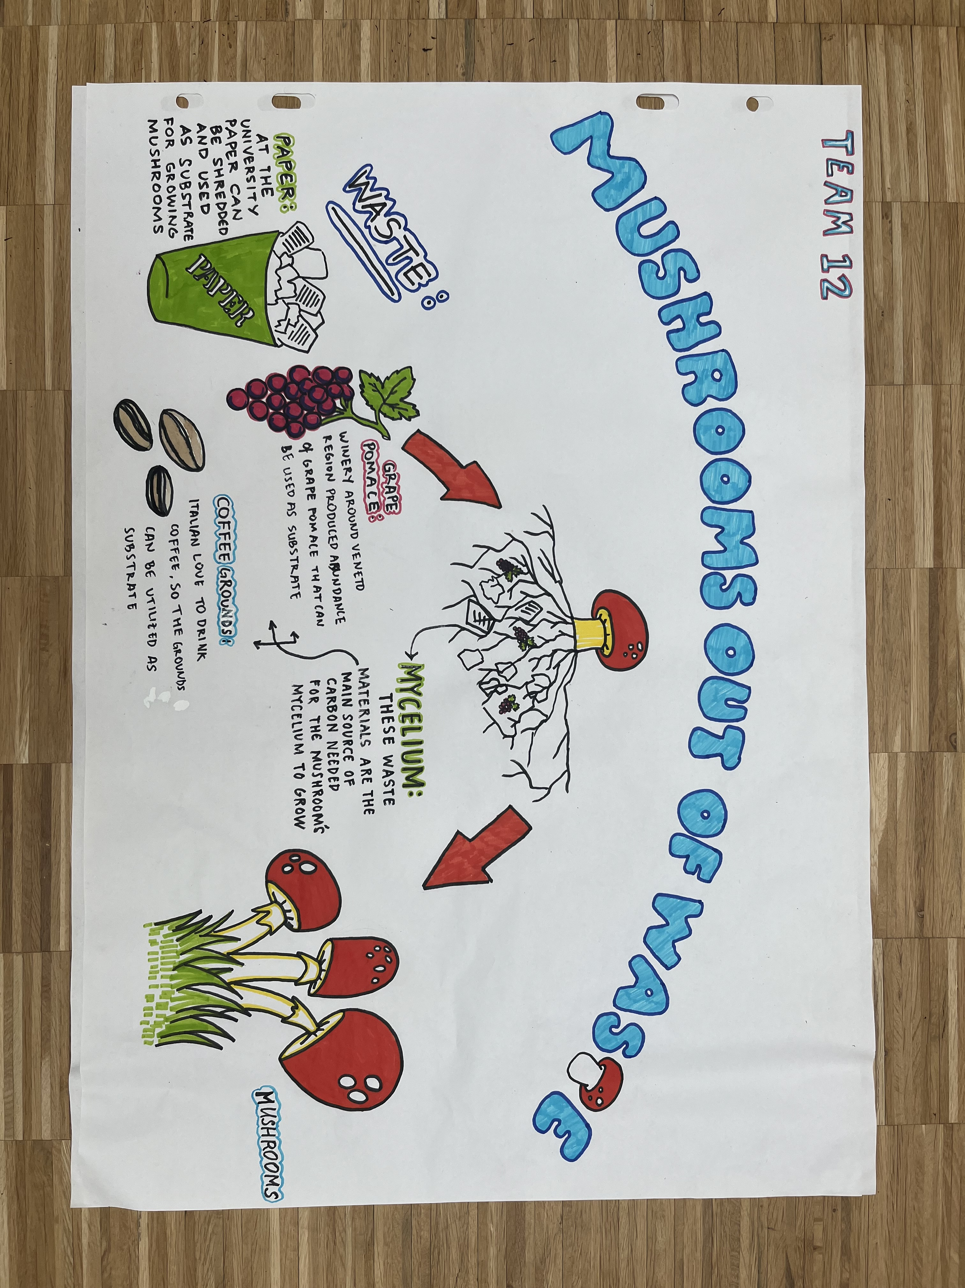
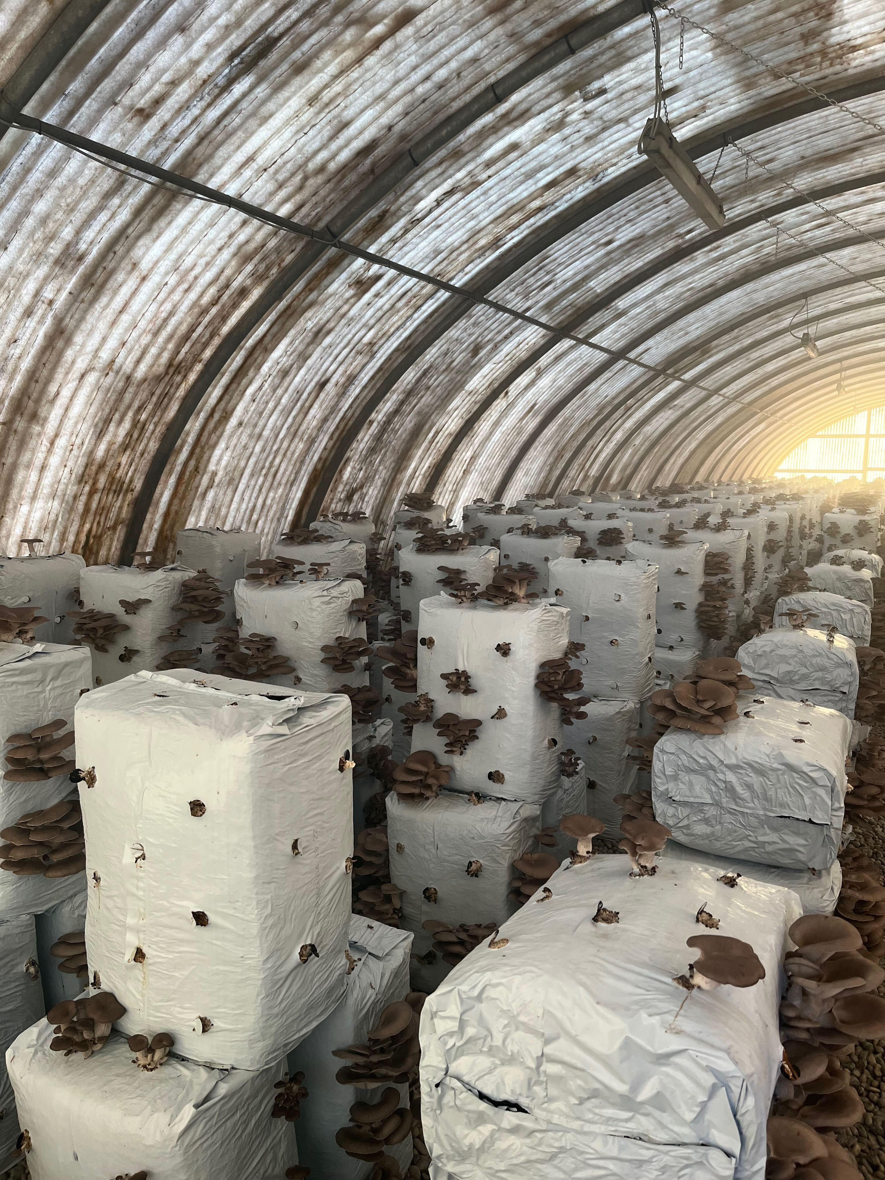
Cultivation of Mushrooms

Slide 6



02
Program Implementation
Of Students
For Students
By Students
Maximising Student Engagement

Slide 7




POTENTIAL
SDG UN Goals
Involvement
Students
Professors & Experts
Local Community
Economic Gain
Profits from selling of Mushrooms
Source University Cafeteria

Slide 8




Contextual Realisation
Monitoring
Tracking Production & Yield
(Quality & Quantity)
Waste Diversification
Cost & Profitability
Level of Engagement by tracking participation in workshops, social media, surveys
How?
When?
Where?
RnD
(regulations, permits suitable for indoor cultivation)
Over the course of the semester
Small scale setup within the confines of university

Slide 9



Restraints of the System
Infrastructure
Substrate
Lack of infrastructure, technical knowledge and funding
Substrate availability and cost, quality control issues

Slide 10
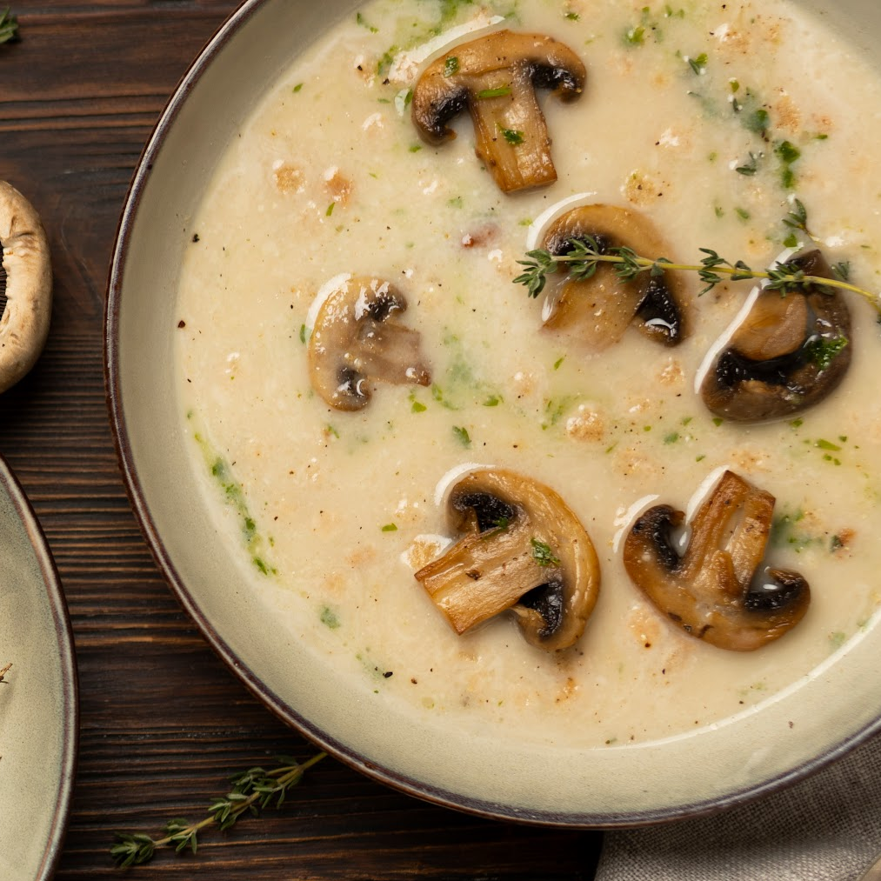
Thank You

